Slide 1

Lecture 8
Graphics Part I
Intro to JavaFX
(photo courtesy of Snapchat filters)

Slide 2

This Lecture
GUIs and JavaFX
JavaFX Scene Graph Hierarchy
Aside: VBox
Example: ColorChanger
Event Handling
Private inner classes
Random number generation
javafx.scene.paint.Colors
Logical vs. Graphical Containment with JavaFX

Slide 3
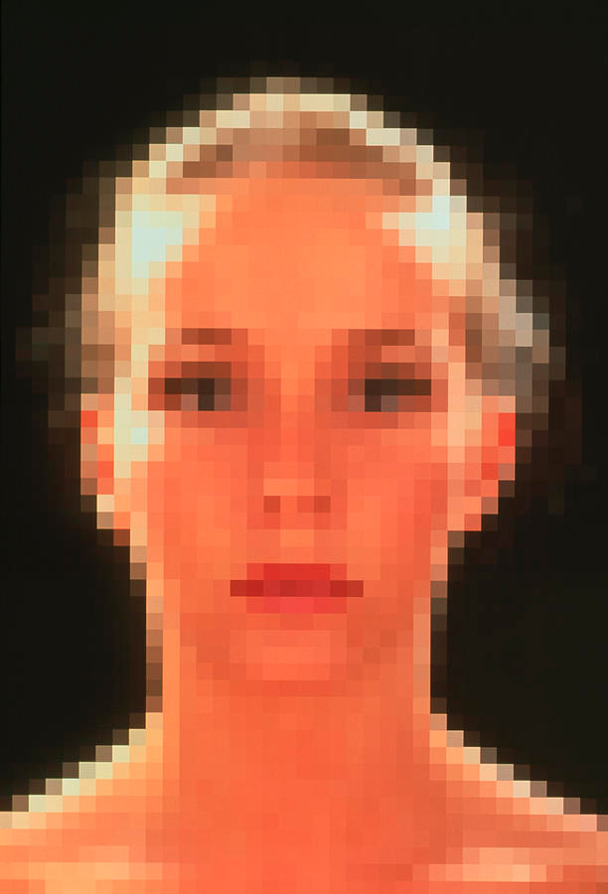
Pixels and Coordinate System
X
(0, 0)
Screen is a grid of pixels (tiny squares, each with RGB components)
Cartesian plane with:
origin in upper-left corner
x-axis increasing left to right
y-axis increasing top to bottom
corresponds to English writing order
Each graphical element is positioned at specific pixel
Y
:
pixels
Former HTA Sam Squires!

Slide 4

What is JavaFX?
Usually don’t want to program at the pixel level – far too tedious!
JavaFX is a set of graphics and media packages enabling developers to design, create, and test powerful graphical applications for desktop, web, and mobile devices
JavaFX is an API (Application Programming Interface) to a graphics and media library: a collection of useful classes and interfaces and their methods (with suitable documentation) – no internals accessible!

Slide 5
Creating Applications from Scratch
Until now, TAs took care of graphical components for you
our support code defined the relevant classes
From now on, you are in charge of this!
JavaFX is quite powerful but can be a bit tricky to wrap your head around because of the size of the JavaFX library
not to fear, all JavaFX packages, classes, and method descriptions can be found in the JavaFX guide on our website!

Slide 6
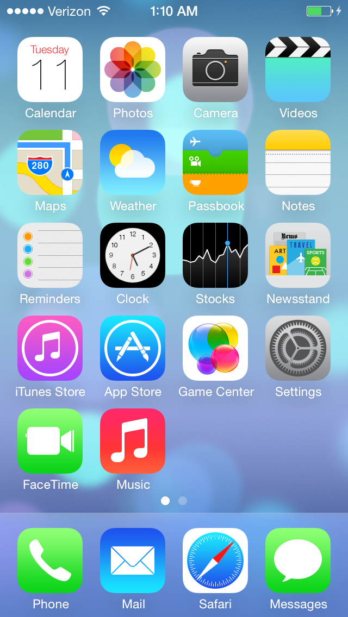
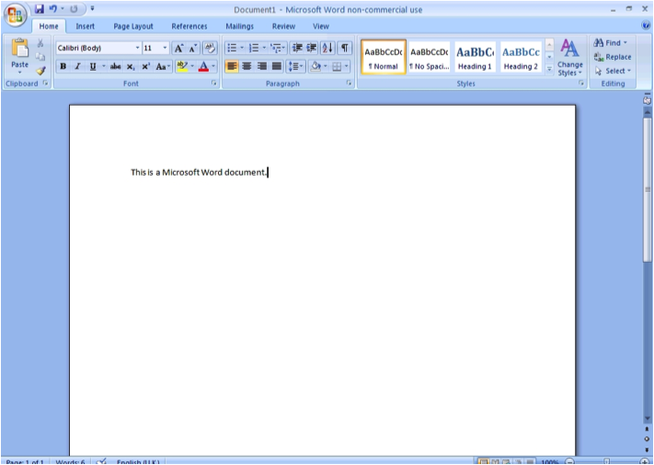
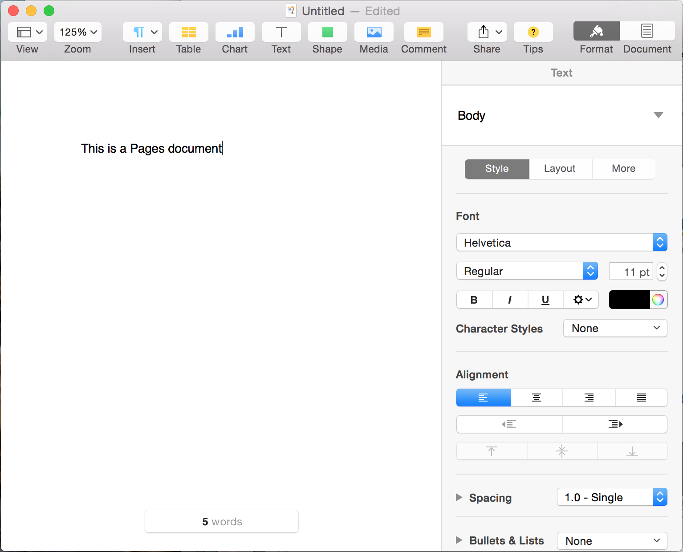
Graphical User Interface (GUIs)
GUIs provide user- controlled (i.e., graphical) way to send messages to a system of objects, typically your app
Use JavaFX to create your own GUIs throughout the semester

Slide 7
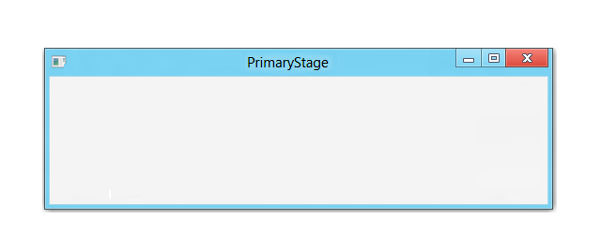

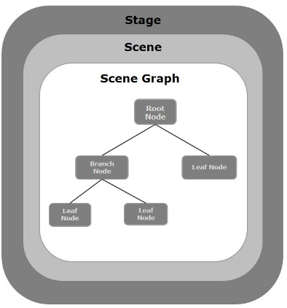
Components of JavaFX application
Stage
location (or “window”) where all graphic elements will be displayed
Scene
container for all UI elements to be displayed on a stage
scene must be on a stage to be visible
Scene Graph
family tree of graphical elements
Nodes
all elements of the Scene Graph
graphical representation called a UI element, widget or control (synonyms)

Slide 8
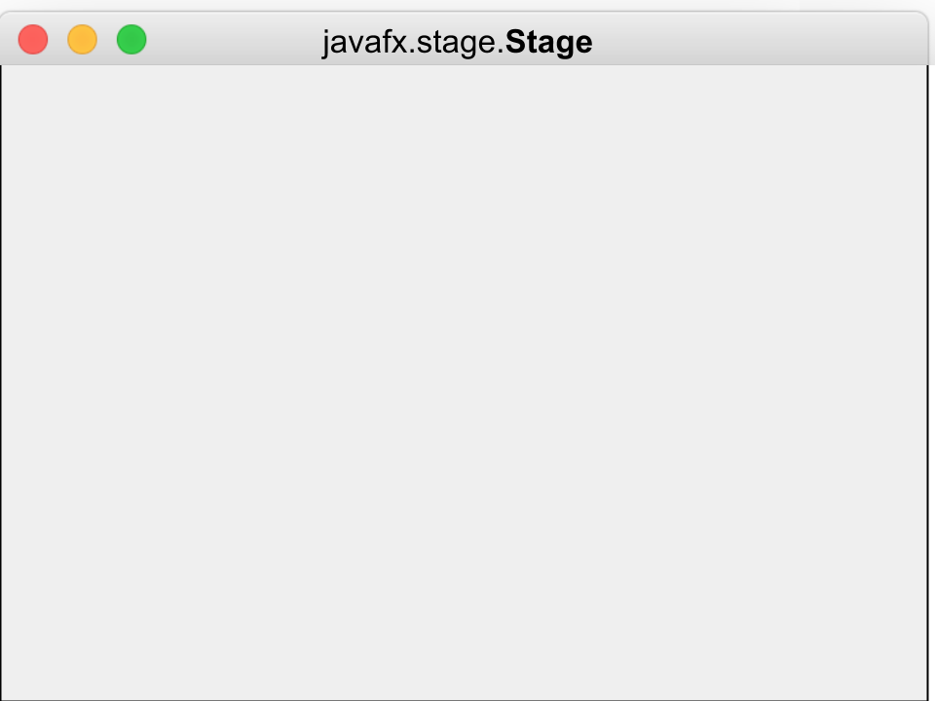
Creating GUIs With JavaFX (1/2)
public class App extends Application {
//mainline provided by TAs elided
@Override
public void start( ) {
stage.show();
}
}
App class for our main JavaFX application extends the imported abstract class javafx.application.Application
From now on in CS15, we’ll begin every project by implementing the Application class’ start method
start is called automatically by JavaFX to launch program
Java automatically creates a Stage using the imported javafx.stage.Stage class, which is passed into start method
the stage becomes a window for the application when stage’s show method is called in the Application class’ start method.
Stage stage

Slide 9
Creating GUIs With JavaFX (2/2)
In order for our application to provide content for what to show on the stage, must first set (specify) a scene before showing it on (in) the stage
javafx.scene.Scene is the top-level container for all UI elements
first instantiate Scene within App class’ start method
then pass that Scene into Stage’s setScene(Scene scene) method to set the scene!
In CS15, only specify 1 Scene – though JavaFX does permit creation of applications with multiple Scenes
ex: A gaming application where you could select to play either DoodleJump, Tetris or Pacman from the main screen might utilize multiple Scenes - one for each subgame
So what exactly is a javafx.scene.Scene ?
Process shown in a few slides!

Slide 10
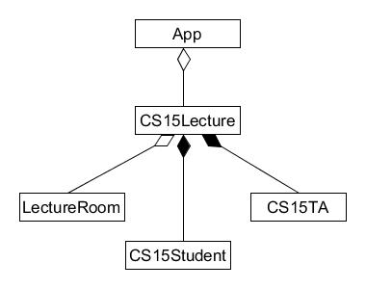
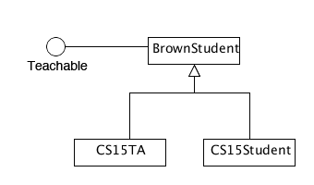
JavaFX Scene Graph Hierarchy (1/3)
In JavaFX, contents of the Scene (UI elements) are represented as a hierarchical tree, known as the Scene Graph
you are familiar with some other hierarchies already - containment and inheritance
containment hierarchy
inheritance hierarchy
directed graph

Slide 11
JavaFX Scene Graph Hierarchy (2/3)
Think of the Scene Graph as a family tree of visual elements
javafx.scene.Node is the abstract superclass for all UI elements that can be added to the Scene, such as a Button or a Label
all UI elements are concrete subclasses of Node (Button, Label, Pane, etc.)
Each UI component that is added to the Scene Graph as a Node gets displayed graphically
Node
Node
Node
Node
Node
Node

Slide 12
JavaFX Scene Graph Hierarchy (3/3)
root Node
Each Node can have multiple children but at most one parent
child Nodes are almost always graphically contained in their parent Node
more on graphical containment later!
The Node at the top of the Scene Graph is called the root Node
the root Node has no parent
This node has two children
Node
Node
Node
Node
Node

Slide 13
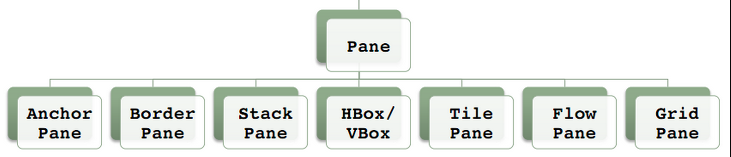
The root of the Scene
In CS15, root Node will always be a javafx.scene.layout.Pane or one of Pane’s subclasses.
Different Panes have different built-in layout capabilities to allow easy positioning of UI elements - see inheritance tree below for flavors
For now, use a VBox as the root of the Scene– more on VBox later

Slide 14
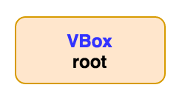
Constructing the Scene Graph (1/3)
Instantiate root Node
public class App extends Application {
@Override
public void start(Stage stage) {
//code to populate Scene Graph
VBox root = new VBox();
Scene scene = new Scene(root);
stage.setScene(scene);
stage.show();
}
}

Slide 15
Constructing the Scene Graph (2/3)
Instantiate root Node
Then pass it into Scene constructor to construct Scene Graph
Scene Graph starts off as a single root Node with no children
the root is simply a container, without graphical shape
/*within top-level pp class*/
public void start (Stage stage) {
VBox root = new VBox();
Scene scene = new Scene(root);
}
public class App extends Application {
@Override
public void start(Stage stage) {
//code to populate Scene Graph
VBox root = new VBox();
Scene scene = new Scene(root);
stage.setScene(scene);
stage.show();
}
}

Slide 16
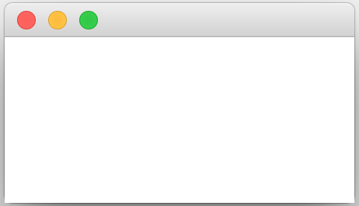
Constructing the Scene Graph (3/3)
Once we setScene() and show() on Stage, we begin populating the Scene Graph
public class App extends Application {
@Override
public void start(Stage stage) {
//code to populate Scene Graph
VBox root = new VBox();
Scene scene = new Scene(root);
stage.setScene(scene);
stage.show();
}
}

Slide 17
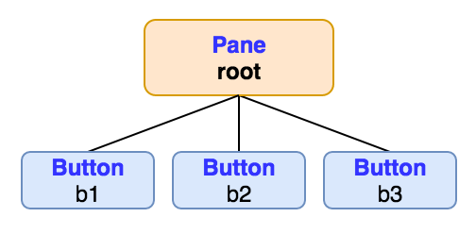
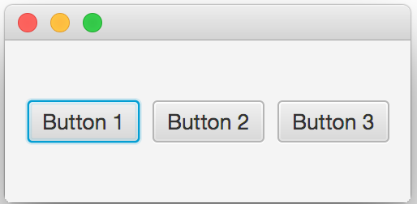
Adding UI Elements to the Scene (1/2)
How do we add more Nodes to the Scene Graph?
Adding UI elements as children of root Node will add them to Scene and make them appear on the Stage!
Calling getChildren() method on a Node returns a list of that Node’s children
by adding/removing Nodes from a Node’s list of children, we can add/remove Nodes from the Scene Graph!

Slide 18
Adding UI Elements to the Scene (2/2)
getChildren() returns a List of child Nodes
in example on right, root.getChildren() returns a List holding three Buttons (assuming we created them previously - next slide)
To add a Node to this list of children, call add(Node node) on that returned List!
can also use addAll(Nodes… node1, node2, …) which takes in any number of Nodes
allowing any number of arguments is a new capability of parameter lists
To remove a Node from this list of children, call remove(Node node) on that returned List

Slide 19
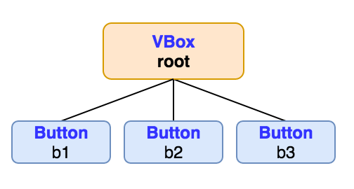
root.getChildren().add(…) in action
Add 3 Buttons to the Scene by adding them as children of the root Node (no children before this)
First create buttons
Then add buttons to Scene Graph
Order matters - order buttons added effects order displayed
(b1, b2, b3) vs. (b2, b1, b3)
/* Within App class */
@Override
public void start(Stage stage) {
//code for setting root, stage, scene elided
Button b1 = new Button(“Button 1”);
Button b2 = new Button(“Button 2”);
Button b3 = new Button(“Button 3”);
root.getChildren().addAll(b1,b2,b3);
}
Note the default button selection in blue
Remember double dot method call shorthand?
root.getChildren() returns a List of root’s children. Rather than storing that returned List in a variable and calling add(…) on that variable, we can simplify our code by calling add(…) directly on the returned List of children!

Slide 20
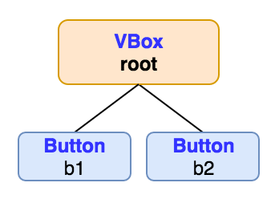
Removing UI Elements from the Scene (2/2)
Similarly, remove a UI element by removing it from root’s children
note: order of children doesn’t matter when removing elements since you specify their variable names
Let’s remove third Button*
/* Within App class */
@Override
public void start(Stage stage) {
//code for setting root, stage, scene elided
Button b1 = new Button(“Button 1”);
Button b2 = new Button(“Button 2”);
Button b3 = new Button(“Button 3”);
root.getChildren().addAll(b1,b2,b3);
root.getChildren().remove(b3);
}
*Note: not a typical design choice to add and then remove a Node in the same code block!

Slide 21
Populating the Scene Graph (1/3)
What if we want to make more complex applications?
Add specialized layout containers, called Panes
Add another Pane as child of root Node, then add more UI elements as child Nodes of this Pane – next slide
This will continue to populate the scene graph!

Slide 22
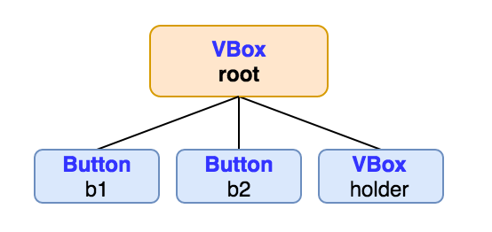
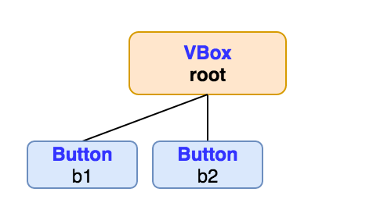
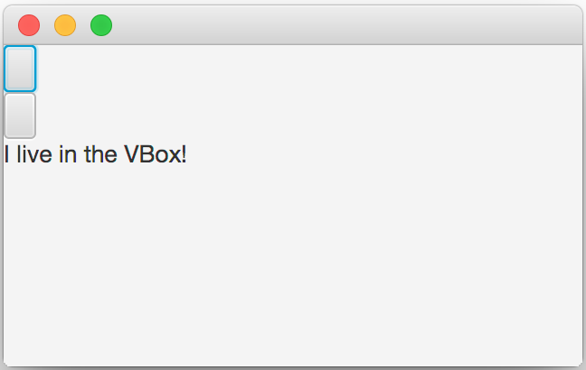
Populating the Scene Graph (2/3)
First, instantiate another VBox and add it as child of root Node
Note: VBox is a pure container without graphical shape
/* Within App class */
@Override
public void start(Stage stage) {
//code for setting scene elided
Button b1 = new Button(); //no label
Button b2 = new Button(); //no label
root.getChildren().addAll(b1,b2);
VBox holder = new VBox();
root.getChildren().add(holder);
}

Slide 23
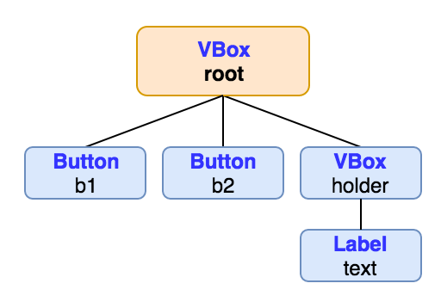
Populating the Scene Graph (3/3)
Next, add Label to Scene as child of new VBox
/* Within App class */
@Override
public void start(Stage stage) {
//code for setting scene elided
Button b1 = new Button();
Button b2 = new Button();
root.getChildren().addAll(b1,b2);
VBox holder = new VBox();
root.getChildren().add(holder);
}
Label text = new Label(
“I live in the VBox!”);
holder.getChildren().add(text);

Slide 24
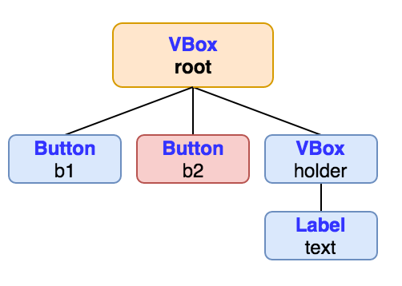
Removing a Node with children (1/3)
Removing a Node with no children simply removes that Node…
root.getChildren().remove(b2); to remove second Button

Slide 25
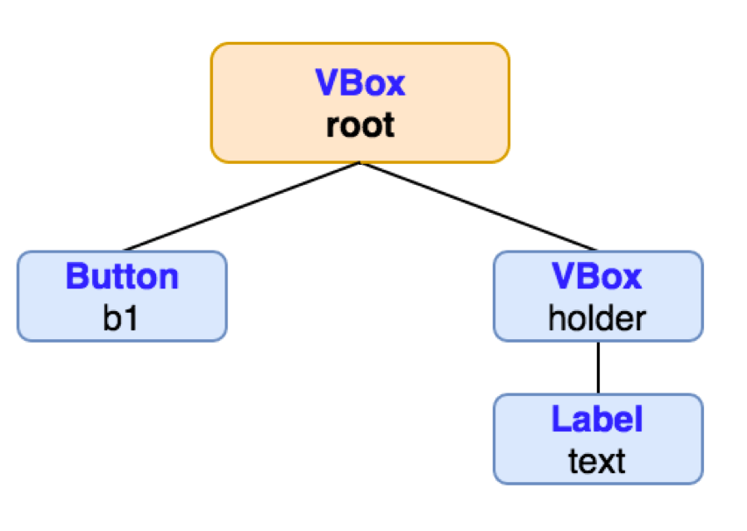
Removing a Node with children (2/3)
Note that removing a Node with no children simply removes that Node…
root.getChildren().remove(b2); to remove second Button
Removing a Node with children removes all of its children as well!
root.getChildren().remove(holder); makes both VBox and Label disappear

Slide 26
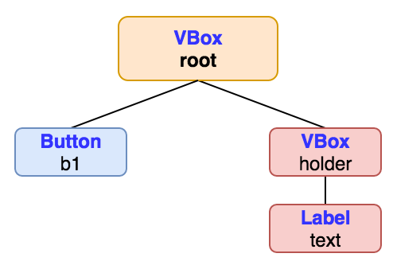
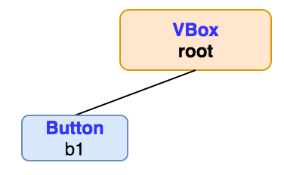
Removing a Node with children (3/3)
Note that removing a Node with no children simply removes that Node…
root.getChildren().remove(b2); to remove second Button
Removing a Node with children removes all of its children as well!
root.getChildren().remove(holder); makes both VBox and Label disappear

Slide 27
TopHat Question
Which of the following correctly would next remove removeLabel from the VBox holder?
root.remove(removeLabel);
holder.remove(removeLabel);
root.getChildren.remove(removeLabel);
holder.getChildren().remove(removeLabel);
Given this code:
public void start(Stage stage) {
//code for setting scene elided
Button b1 = new Button();
Button b2 = new Button();
root.getChildren().addAll(b1,b2);
VBox holder = new VBox();
root.getChildren().add(holder);
Label removeLabel = new Label(“remove me!”);
holder.getChildren().add(removeLabel);
}

Slide 28

VBox layout pane (1/5)
So what exactly is a VBox?
VBox layout Pane creates an easy way for arranging a series of children in a single vertical column
We can customize vertical spacing between children using VBox’s setSpacing(double) method
the larger the double passed in, the more space between the child UI elements

Slide 29
VBox layout pane (2/5)
Can also set positioning of entire vertical column of children
Default positioning for the vertical column is in TOP_LEFT of VBox (Top Vertically, Left Horizontally)
can change Vertical/Horizontal positioning of column using VBox’s setAlignment(Pos position) method, passing in a javafx.geometry.Pos constant — javafx.geometry.Pos is a class of enums, or fixed set of values, to describe vertical and horizontal positioning. Use these values just like a constants class that you would write yourself!
Pos options are in the form Pos.<vertical position>_<horizontal position>
e.g. Pos.BOTTOM_RIGHT represents positioning on the bottom vertically, right horizontally
full list of Pos constants can be found here
Why ALL_CAPS notation ?
It is a “symbolic constant” with pre-defined meaning.

Slide 30
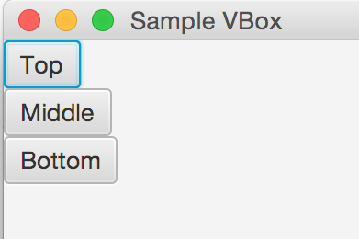
VBox layout pane (3/5)
The following code produces the example on the right:
VBox root = new VBox();
Button b1 = new Button(“Top”);
Button b2 = new Button(“Middle”);
Button b3 = new Button(“Bottom”);
root.getChildren().addAll(b1,b2,b3);
width, height
Scene scene = new Scene(root, 200, 200);
stage.setTitle("Sample VBox");
stage.setScene(scene);
stage.show();
Overloaded Scene constructor with three parameters

Slide 31
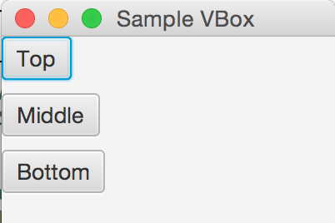
VBox layout pane (4/5)
Adding spacing between children
VBox root = new VBox();
Button b1 = new Button(“Top”);
Button b2 = new Button(“Middle”);
Button b3 = new Button(“Bottom”);
root.getChildren().addAll(b1,b2,b3);
root.setSpacing(8);
//code for setting the Scene elided

Slide 32
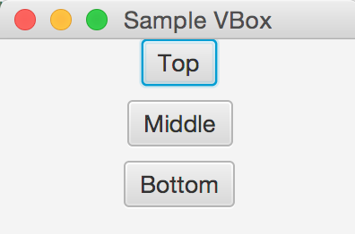
VBox layout pane (5/5)
Setting alignment property to configure children in TOP (vertically) CENTER (horizontally) of the VBox
VBox root = new VBox();
Button b1 = new Button(“Top”);
Button b2 = new Button(“Middle”);
Button b3 = new Button(“Bottom”);
root.getChildren().addAll(b1,b2,b3);
root.setSpacing(8);
root.setAlignment(Pos.TOP_CENTER);
//code for setting the Scene elided

Slide 33
CS15 PaneOrganizer Class (1/2)
Until now, all code dealing with the Scene has been inside Application’s start method; adding more nodes will clutter it up…
In CS15, write a PaneOrganizer class where all graphical application logic will live – an example of “delegation” pattern
Delegation removes application-dependent code from App class, which only creates scene and instantiates a PaneOrganizer – another example of “divide et impera”
PaneOrganizer will instantiate root Pane, and provide a public getRoot() method that returns this root
App class can now access root Pane through PaneOrganizer’s public getRoot() method and pass root into Scene constructor
We’ll do this together soon!

Slide 34
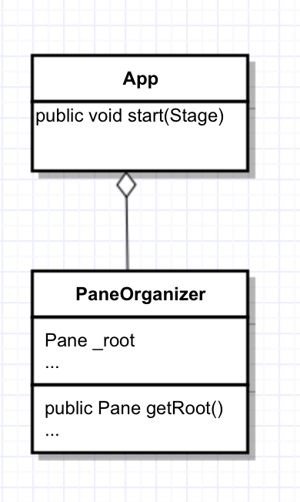
CS15 PaneOrganizer Class (2/2)
Pattern
App class instantiates a PaneOrganizer, which creates root
Then App class passes return value from getRoot() to Scene constructor, so Scene has a root
Top-level PaneOrganizer class instantiates JavaFX UI components (Button,Label,Pane…)
These UI components are then added to root Pane (and the Scene, indirectly) using root.getChildren().add(...); or root.getChildren().addAll(...);

Slide 35
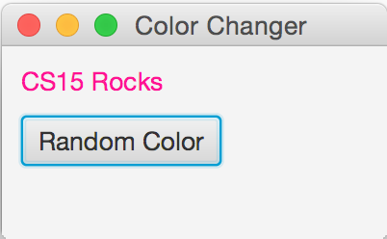
Our First JavaFX Application: ColorChanger
Stage
Spec: App that contains text reading “CS15 Rocks!” and a Button that randomly changes text’s color with every click
Useful classes: Stage, Scene, VBox, Label, Button, EventHandler
Label
Pane (e.g., Vbox)
Scene
Button

Slide 36
Process: ColorChanger
Stage
Create App class that extends javafx.application.Application and implements start (where you set Scene) – the standard pattern
Create PaneOrganizer class that instantiates root Pane and provides public getRoot() method to return the Pane. In PaneOrganizer, instantiate a Label and Button and add them as children of root Pane
Set up a custom EventHandler that changes Label’s color each time Button is clicked, and register Button with this new ClickHandler
Label
Pane (e.g., Vbox)
Scene
Button

Slide 37
ColorChanger: App class (1/3)
To implement start:
Instantiate a PaneOrganizer and store it in the local variable organizer
public class App extends Application {
@Override
public void start(Stage stage) {
PaneOrganizer organizer = new PaneOrganizer();
/*write our PaneOrganizer class later, where we will instantiate the root Pane */
}
}

Slide 38
ColorChanger: App class (2/3)
To implement start:
Instantiate a PaneOrganizer and store it in the local variable organizer
Instantiate a new Scene, passing in:
root Pane, accessed through organizer’s public getRoot()
along with desired width and height of Scene
Set the Scene, title the Stage, and show the Stage!
public class App extends Application {
@Override
public void start(Stage stage) {
PaneOrganizer organizer = new PaneOrganizer(); /*write our PaneOrganizer class later, where we will instantiate the root Pane */
Scene scene =
new Scene(organizer.getRoot(),80,80);
stage.set(scene);
stage.setTitle(“Color Changer!”);
stage.show();
}
}
root width height

Slide 39
ColorChanger: App class (3/3)
To implement start:
Instantiate a PaneOrganizer and store it in the local variable organizer
Instantiate a new Scene, passing in:
the root Pane, which is accessed through organizer public getRoot() method
along with desired width and height of Scene
Set the Scene, title the Stage, and show the Stage
public class App extends Application {
@Override
public void start(Stage stage) {
PaneOrganizer organizer = new PaneOrganizer(); /*write our PaneOrganizer class later, where we will instantiate the root Pane*/
Scene scene =
new Scene(organizer.getRoot(),80,80);
stage.setScene(scene);
stage.setTitle(“Color Changer!”);
stage.show();
}
}

Slide 40
Process: ColorChanger
Stage
Create App class that extends javafx.application.Application and implements start (where you set Scene!)
Create PaneOrganizer class that instantiates root Pane and provides public getRoot() method to return the Pane. In PaneOrganizer, instantiate a Label and Button and add them as children of root Pane
Set up a custom EventHandler that changes Label’s color each time Button is clicked, and register Button with this new ClickHandler
Label
Pane (e.g.,Vbox)
Scene
Button

Slide 41
ColorChanger: Our PaneOrganizer Class (1/4)
To write PaneOrganizer class:
Instantiate root VBox and store it in instance variable _root
public class PaneOrganizer {
private VBox _root;
private Label _label;
public PaneOrganizer() {
_root = new VBox();
_label = new Label(“CS15 Rocks!”);
Button btn = new Button(“Random Color”);
_root.getChildren().addAll(_label,btn);
_root.setSpacing(8);
btn.setOnAction(new ClickHandler());
}
public VBox getRoot() return _root;
}
}

Slide 42
ColorChanger: Our PaneOrganizer Class (2/4)
To write PaneOrganizer class:
Instantiate root VBox and store it in instance variable _root
Create a public getRoot() method that returns _root
reminder: this makes root Pane accessible from within App’s start for new Scene(root)
public class PaneOrganizer {
private VBox _root;
private Label _label;
public PaneOrganizer() {
_root = new VBox();
_label = new Label(“CS15 Rocks!”);
Button btn = new Button(“Random Color”);tChildren().addAll(_label,btn);
_root.setSpacing(8);
btn.setOnAction(new ClickHandler());
}
public VBox getRoot() {
return _root;
}
}

Slide 43
ColorChanger: Our PaneOrganizer Class (3/4)
To write PaneOrganizer class:
Instantiate Label and Button, passing in String representations of text we want displayed
_label is an instance variable because need to access it elsewhere in P.O. to change its color
btn is a local variable because only need to access it from within constructor
Add Label and Butt on as children of root
root.setSpacing(8) is optional but creates a nice vertical distance between Label and Button
public class PaneOrganizer {
private VBox _root;
private Label _label;
public PaneOrganizer() {
_root = new VBox();
_label = new Label(“CS15 Rocks!”);
Button btn = new Button(“Random Color”);andler());
}
public VBox getRoot() {
return _root;
}
}

Slide 44
ColorChanger: Our PaneOrganizer Class (4/4)
To write PaneOrganizer class:
Instantiate Label and Button, passing in String representations of text we want displayed
_label is an instance variable because need to access it elsewhere in P.O. to change its color
btn is a local variable because only need to access it from within constructor
Add Label and Button as children of root
root.setSpacing(8) is optional but creates a nice vertical distance between Label and Button
public class PaneOrganizer {
private VBox _root;
private Label _label;
public PaneOrganizer() {
_root = new VBox();
_label = new Label(“CS15 Rocks!”);
Button btn = new Button(“Random Color”); _root.getChildren().addAll(
_label,btn);
_root.setSpacing(8); btn.setOnAc
}
public VBox getRoot() {
return _root;
}
}

Slide 45
Process: ColorChanger
Stage
Create App class that extends javafx.application.Application and implements start (where you set Scene!)
Create PaneOrganizer class that instantiates root Pane and provides public getRoot() method to return the Pane. In PaneOrganizer, instantiate a Label and Button and add them as children of root Pane
Set up a custom EventHandler that changes Label’s color each time Button is clicked, and register Button with this new ClickHandler
Label
Pane (eg. Vbox)
Scene
Button

Slide 46


Responding to User Input
Need a way to respond to stimulus of Button being clicked
We refer to this as Event Handling
a source (Node), such as a Button, generates an Event (such as a mouse click) and notifies all registered EventHandler objects
EventHandler is an interface, so all classes that implement EventHandler must implement handle(Event event) method, which defines response to event
note that handle(Event event) is called by JavaFX, not the programmer

Slide 47
EventHandlers (1/3)
Button click causes JavaFX to generate a javafx.event.ActionEvent
ActionEvent is only one of many JavaFX EventTypes that are subclasses of Event class
Classes that implement EventHandler interface can polymorphically handle any subclass of Event
when a class implements EventHandler interface, it must specify what type of Event it should know how to handle
how do we do this?
EventHandler interface declared as: public interface EventHandler<T extends Event>…
the code inside literal < > is known as a “generic parameter” – this is magic for now
lets you specialize the interface to deal in all its methods only with a specialized subclass of Event
forces you to replace what is inside the literal < > with some subclass of Event, such as ActionEvent, whenever you write a class that implements EventHandler interface (next slide)

Slide 48
EventHandlers (2/3)
public class ClickHandler implements EventHandler<ActionEvent> {
public void handle(ActionEvent e) {
//code to change _cs15Rocks Label
}
}
We can create an EventHandler and call it ClickHandler
This EventHandler will handle an ActionEvent, meaning that ClickHandler will implement the “EventHandler<ActionEvent>” interface
literally, “< >” included!!

Slide 49
EventHandlers (3/3)
public class ClickHandler implements EventHandler<ActionEvent> {
public ClickHandler() { //code elided }
@Override
public void handle(ActionEvent e) {
//code to change _myLabel Label
}
}
Our ClickHandler must implement the handle(ActionEvent e) method of the EventHandler interface, which will specify the response to the ActionEvent (in this case, a click)
for now, you most likely won’t need to use the parameter e
To tell this new ClickHandler to listen for the Button’s ActionEvent, register Button with the ClickHandler by calling btn.setOnAction, passing in an instance of our ClickHandler class
the mechanics of handing off the event to the handler happen under hood of JavaFX
//elsewhere in program
public class PaneOrganizer {
//instance variable declarations elided
public PaneOrganizer() {
_root = new VBox();
_label = new Label(“CS15 Rocks!”);
Button btn = new Button(“Random Color”);
_root.getChildren().addAll(_label,btn);
_root.setSpacing(8);
btn.setOnAction(new ClickHandler());
}
//code to return root elided
}

Slide 50
Back to Process: ColorChanger
Stage
Create App class that extends javafx.application.Application and implements start (where you set Scene!)
Create PaneOrganizer class that instantiates root Pane and provides public getRoot() method to return the Pane. In PaneOrganizer, instantiate a Label and Button and add them as children of root Pane
Define a custom EventHandler that changes Label’s color each time Button is clicked, and register Button with this new ClickHandler
Label
Pane (eg. Vbox)
Scene
Button

Slide 51
ColorChanger: ClickHandler class
Defining our custom EventHandler, ClickHandler:
ClickHandler must listen for click event and respond to it by changing the color of “CS15 Rocks!” Label
How will ClickHandler access Label?
multiple ways to do this: could have ClickHandler constructor take in a Label as a parameter
this works, but is there a better way?
public class ClickHandler implements EventHandler<ActionEvent> {
private Label _myLabel;
public ClickHandler( ) {
_myLabel = label;
}
@Override
public void handle(ActionEvent e) {
//code to change _myLabel Label
}
}
Label label

Slide 52

Aside: Private Inner Classes (1/2)
Until now, all classes we have created have been public
live in their own file
can be accessed from within any class
Introducing private inner classes!
useful when there is a class, such as an EventHandler, for which you only need to create a single instance, from within a single class
private inner classes have access to instance variables/methods of the class that contains them (that declared them)
inner classes are a convenient and safe shortcut -- don’t require a file

Slide 53
Aside: Private Inner Classes (2/2)
Rather than making the ClickHandler class a public class in its own file, we can make it a private inner class of the PaneOrganizer class
Our ClickHandler will then have access to PaneOrganizer’s _label instance variable
Can then set _label’s text color from within ClickHandler’s handle(ActionEvent) method, without needing to deal with any unnecessary passing around of references to Label

Slide 54
ColorChanger: ClickHandler Private Inner Class (1/2)
public class PaneOrganizer {
private VBox _root;
private Label _label;
public PaneOrganizer() {
_root = new VBox();
_label = new Label(“CS15 Rocks!”);
Button btn = new Button(“Random Color”);
_root.getChildren().addAll(_label,btn);
_root.setSpacing(8);
}
public VBox getRoot() {
return _root;
}
private class ClickHandler implements EventHandler<ActionEvent> {
}
}
Defining our custom EventHandler, ClickHandler:
In order to make ClickHandler a private inner class of PaneOrganizer class, we simply declare ClickHandler as a private class and place it within braces of public PaneOrganizer class

Slide 55
ColorChanger: ClickHandler Private Inner Class (2/2)
public class PaneOrganizer {
private VBox _root;
private Label _label;
public PaneOrganizer() {
_root = new VBox();
_label = new Label(“CS15 Rocks!”);
Button btn = new Button(“Random Color”);
_root.getChildren().addAll(_label,btn);
_root.setSpacing(8);
}
public VBox getRoot() {
return _root;
}
private class ClickHandler implements EventHandler<ActionEvent> {
public ClickHandler() { //code and annotations elided}
public void handle(ActionEvent event) {
//implementation elided for now
}
}
}
Defining our custom EventHandler, ClickHandler:
Now must implement handle method
How will ClickHandler generate a random color whenever btn’s ActionEvent is detected?

Slide 56
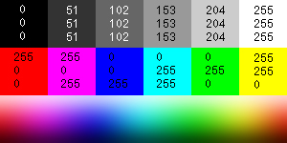
Generating javafx.scene.paint.Colors
We can generate most colors of visible color spectrum by additive mixtures of Red, Green and Blue “primaries” generated by display hardware
each display pixel has a R,G, and B sub-pixels to do this color mixing
javafx.scene.paint.Color has static method rgb(int red, int green, int blue) that returns a custom color according to specific passed-in Red, Green, and Blue integer values in [0-255]
ex: Color.WHITE can be expressed as Color.rgb(255,255,255)

Slide 57
ColorChanger: Our EventHandler, ClickHandler
Defining our custom EventHandler, ClickHandler:
Math.random() returns a random double between 0 inclusive and 1 exclusive
Multiplying this value by 256 turns [0, 1) double into a [0, 255) double, which we cast to a [0,255] int by using (int) cast operator
Use these ints as Red, Green, and Blue RGB values for a custom javafx.scene.paint.Color
Call setTextFill on _label, passing in new random Color we’ve created
private class ClickHandler implements EventHandler<ActionEvent> {
public ClickHandler() {
//code elided
}
@Override
public void handle(ActionEvent event) {
int red = (int) (Math.random()*256);
int green = (int) (Math.random()*256);
int blue = (int) (Math.random()*256);
Color customColor = Color.rgb(red,green,blue);
_label.setTextFill(customColor);
}
}

Slide 58
ColorChanger: Back to our PaneOrganizer Class
public class PaneOrganizer {
private VBox _root;
private Label _label;
public PaneOrganizer() {
_root = new VBox();
_label = new Label(“CS15 Rocks!”);
Button btn = new Button(“Random Color”);
_root.getChildren().addAll(_label,btn);
_root.setSpacing(8);
btn.setOnAction(new ClickHandler());
}
public VBox getRoot() {
return _root;
}
private class ClickHandler implements EventHandler<ActionEvent> {
// code on previous slide
}
}
Defining our custom EventHandler, ClickHandler:
Last step is to register the Button with the click Event
To do so, call setOnAction on btn, passing in an instance of our ClickHandler (Did this on S49)

Slide 59
The Whole App: ColorChanger
public class PaneOrganizer {
private VBox _root;
private Label _label;
public PaneOrganizer() {
_root = new VBox();
_label = new Label(“CS15 Rocks!”);
Button btn = new Button(“Random Color”);
_root.getChildren().addAll(_label,btn);
_root.setSpacing(8);
btn.setOnAction(new ClickHandler());
}
public VBox getRoot() {
return _root;
}
private class ClickHandler
implements EventHandler<ActionEvent> {
//constructor elided
@Override
public void handle(ActionEvent event) {
int red = (int) (Math.random()*256);
int green = (int) (Math.random()*256);
int blue = (int) (Math.random()*256);
Color customColor =
Color.rgb(red,green,blue);
_label.setTextFill(customColor); }
}
}
//App class imports
import javafx.stage.Stage;
import javafx.scene.Scene;
import javafx.application.*;
// package includes Pane class and its subclasses
import javafx.scene.layout.*;
//package includes Label, Button classes
import javafx.scene.control.*;
//package includes ActionEvent, EventHandler classes
import javafx.event.*;
import javafx.scene.paint.Color;
public class App extends Application {
@Override
public void start(Stage stage) {
PaneOrganizer organizer = new PaneOrganizer();
Scene scene = new Scene(organizer.getRoot(),80,80);
stage.setScene(scene);
stage.setTitle("Color Changer");
stage.show();
}
}

Slide 60
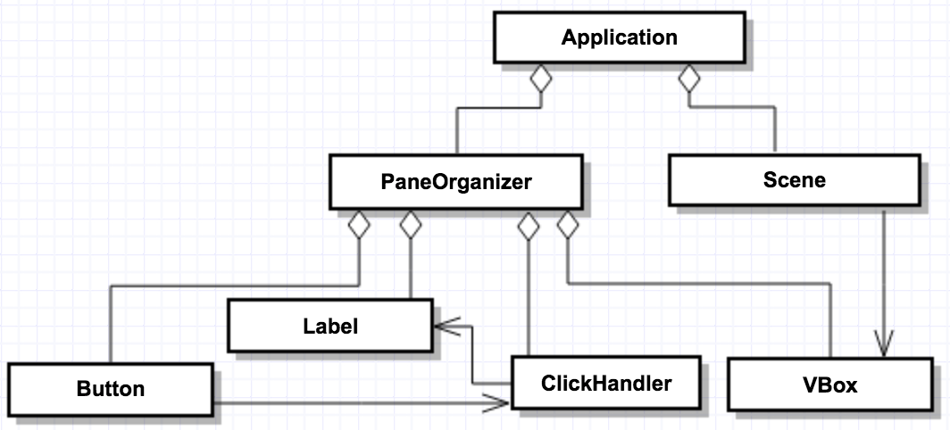
Putting It All Together
association
containment

Slide 61
Logical vs. Graphical Containment/Scene Graph
Stage
Label
Button
VBox
Scene
Graphically, VBox is a pane contained within Scene, but logically, VBox is contained within PaneOrganizer
Graphically, Button and Label are contained within VBox, but logically, Button and Label are contained within PaneOrganizer, which has no graphical appearance
Logical containment is based on where objects are instantiated, while graphical containment is based on JavaFX elements being added to other JavaFX elements via getChildren.add(…) method, and the resulting scene graph

Slide 62

Announcements
FruitNinja deadlines:
Early: Friday, 10/4 at 11:59pm
On-time: Sunday, 10/6 at 11:59pm
Late: Tuesday, 10/8 at 11:59pm
Sections will be a Design Discussion this week!
Please spend some time reviewing these slides on your own to make sure you fully understand them
JavaFX is a dense topic that will be essential to all future assignments
There is a JavaFX guide on the website!
All material will be covered by Graphics III

